Slide 1


Selenium WebDriver: Automating Web Testing
Selenium WebDriver is a powerful tool for automating web application testing. It enables testers to write scripts in various programming languages to control browsers and simulate user interactions. This versatile tool supports cross-browser testing and direct communication with browsers.
by DINESHRAJ DHANAPATHY

Slide 2





Key Features of Selenium WebDriver
Cross-Browser Testing
Supports multiple browsers like Chrome, Firefox, Safari, and Edge for comprehensive testing.
Language Support
Write WebDriver scripts in Java, Python, C#, Ruby, and more for flexibility.
User Action Simulation
Simulates clicks, typing, navigation, and form submissions for thorough testing scenarios.
Open Source
Free to use and supported by a large community of developers.

Slide 3

Components of Selenium WebDriver
1
WebDriver API
Provides a programming interface to control web browsers efficiently and effectively.
2
Browser Drivers
Browser-specific drivers like chromedriver and geckodriver enable WebDriver functionality.
3
Test Script
Custom automation code interacts with web pages using WebDriver commands.

Slide 4

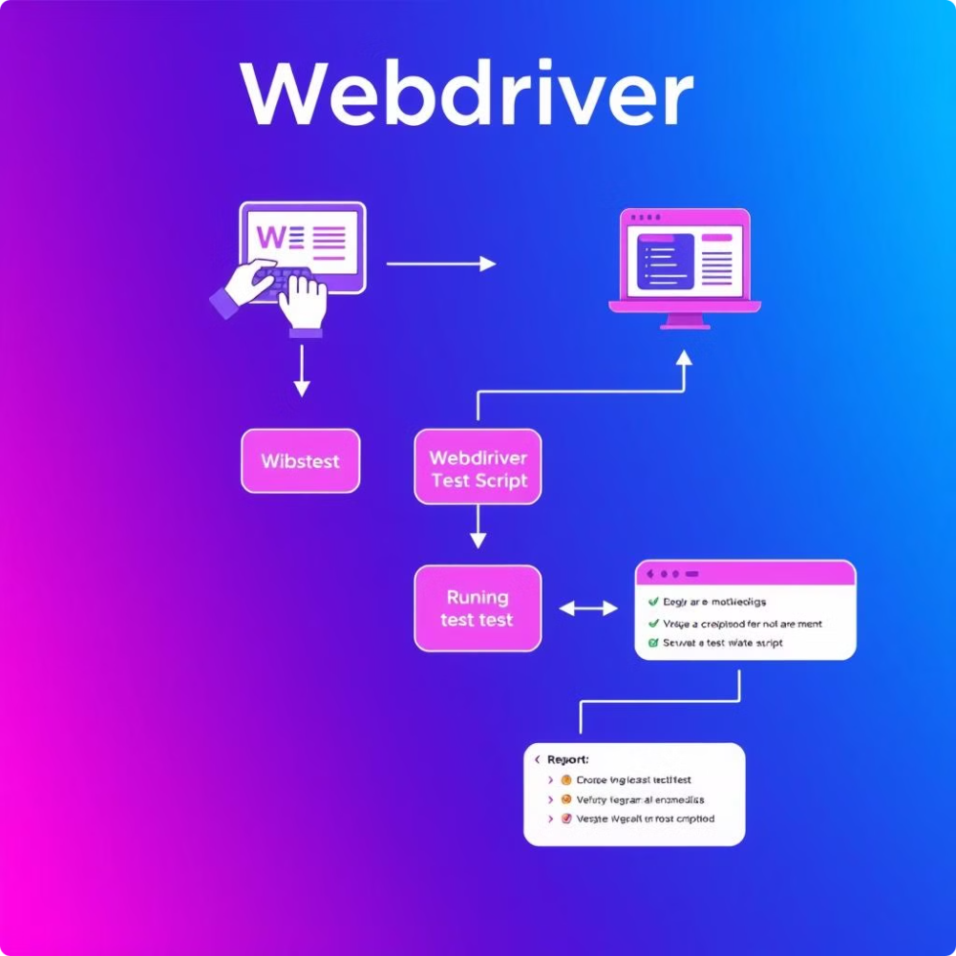
How WebDriver Works
1
Set Up Browser Driver
Download the browser-specific driver and set its path in the system.
2
Write Test Script
Use Selenium commands to automate browser actions and interactions.
3
Run Tests
Execute the script to perform automated browser testing and validation.

Slide 5

Common WebDriver Commands
Navigate to URL
driver.get("https://example.com")
Find an Element
element = driver.find_element_by_id("element_id")
Click an Element
element.click()
Send Text to Input
element.send_keys("your text")
Close Browser
driver.quit()

Slide 6

Best Practices for WebDriver
Use Explicit Waits
Implement explicit waits to avoid race conditions and ensure elements load properly.
Page Object Model (POM)
Structure test scripts using POM for improved maintainability and reusability.
Handle Alerts and Pop-ups
Utilize WebDriver's alert handling mechanisms to manage unexpected dialogs effectively.

Slide 7
Advantages of Selenium WebDriver
Cross-browser Support
Framework Integration
Real User Simulation
Test applications across multiple browsers to ensure consistent functionality and appearance.
Seamlessly integrate with testing frameworks like JUnit, TestNG, and PyTest.
Accurately mimic user interactions for comprehensive and realistic testing scenarios.

Slide 8




Disadvantages of Selenium WebDriver
Programming Knowledge Required
Testers need programming skills to write and maintain WebDriver scripts effectively.
Limited Desktop App Support
WebDriver primarily focuses on web applications, with limited support for desktop testing.
Slower Execution
Tests may run slower compared to headless browser testing methods.

Slide 9

Conclusion: Selenium WebDriver's Impact
Selenium WebDriver is a powerful, versatile tool for automating browser testing. Its cross-browser support, multiple language compatibility, and ability to simulate complex user interactions make it invaluable for automation testing projects. Despite some limitations, WebDriver remains the go-to solution for many developers and testers.

